Slide 1
Highway Safety Manual Implementation
Eric Green, PhD

Slide 2
Kentucky’s Road to Implementing the HSM
Traditional approach
Known issues
Implementation of the HSM
Obstacles
Future improvements

Slide 3
Traditional Approach
Critical Rate

Slide 4
Critical Rate Analysis
Traditional way to quantify safety
Compare a section of road to an average section of road of a similar type
Compare the average rate to that of the critical rate (incorporates a 99.5% confidence)
Produces a Critical Rate Factor

Slide 5
Critical Rate Factor
Ratio of Actual Rate over Critical Rate
CRFs over 1 are more “dangerous” than the average section
Typically sorted descending
Prioritization lists can be generated from the top X percentage
Also used in conjunction with planning metrics to rate all HPMS segments

Slide 6
Known Issues

Slide 7
Known Issues
Crash accuracy
Regression to the mean/randomness
Relation between crashes and AADT

Slide 8
Limits of Critical Rate Analysis
Uses only collisions with county, route, mile point – other collisions excluded
Uses cookie cutter lengths to find sections - it doesn’t find the best section
Collision reports are not correct all the time – read them carefully
Sites with low AADTs tend to move to the top
No accounting for sites with zero crashes
Crash rates may be misleading

Slide 9

Regression To The Mean
U.S. Department of Transportation
Federal Highway Administration
Sir Francis Galton, 1887
  Sweet pea seed size in successive generations
Mean

Slide 10
What Did We Learn?
Crashes and AADT are not necessarily linearly related
Crashes are random events
Naïve before and after analysis can be misleading
Location data can be incorrect
Crash codes can be incorrect

Slide 11
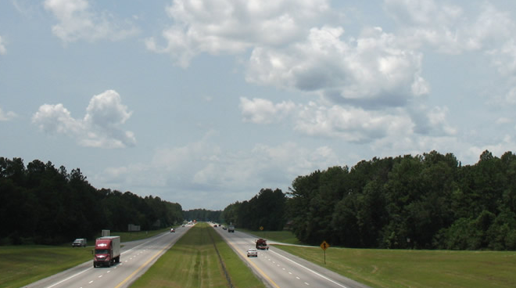
Kentucky Roadway
AADT = 15,000
Crashes (5 years) = 50
Crash Rate = 179
Length = 1.0 mile
$$Crash Rate=\frac{Crashes∗100 M}{Length∗365∗Years∗AADT}$$

Slide 12

Kentucky Roadway
Casinos save lives!!!
AADT = 15,000
Crashes (5 years) = 50
Crash Rate = 179
Length = 1.0 mile
AADT = 30,000
Crashes (5 years) = 85
Crash Rate = 155
Length = 1.0 mile
$$Crash Rate=\frac{Crashes∗100 M}{Length∗365∗Years∗AADT}$$

Slide 13
HSM Implementation

Slide 14
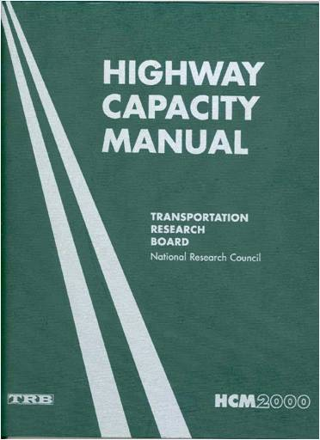
The HSM is…
Analysis tool
Estimations of safety performance
Prediction of crashes
Notes:
The HSM is a toolbox that professionals can use to evaluate or estimate the safety performance of a facility and in this respect is very similar to the Highway Capacity Manual.
The HSM provides users with a process on how to use the tools provided along with direction on which tools are appropriate to use in estimating safety performance.
The HSM provides the user with safety estimates of alternative choices and allows for the development evaluating design options and treatments to improve safety performance.
The HSM provides the required quantitative data for a decision maker to determine the most appropriate solution for a given scenario and support their judgment.

Slide 15
Kentucky’s HSM Experience
Countermeasure prioritization
Intersection safety evaluation
Before and after analysis

Slide 16
Work with Kentucky’s HSIP
Focused on 3 countermeasures:
  High Friction Surface Treatment
  Rumble Strips
  Cable Barrier
KYTC wanted to avoid using CRF analysis…
HSM methodologies are being considered for SHIFT

Slide 17
SPF Development
SPF
Crashes/Year
Average Daily Traffic (ADT)
Notes:
Here is an example of how an SPF can be developed.
Assuming that the four data sets depict the crash experience over 5 years for a set of sites with similar features. It can be assumed that the all sites are 2-lane roads with 12-foot lanes, 8-foot shoulders, and no curves.
A curve is fitted through these 4 entities using a negative binomial regression formula. The line is the “best fit” of all the data and is the Safety Performance Function (SPF). The line represents the change in the mean expected number of crashes at all similar entities as ADT (or other exposure measure) increases, while all other factors affecting crash occurrence are held constant. It should be noted that this is an example and typically SPFs are based on a far greater number of sites for greater accuracy.
Sites that lie above the SPF indicate a mean expected crash frequency in excess of the average for comparable sites. One can think about sites with mean risk above the SPF as those with higher than average risk and those below the line as those with lower than average risk.
SPFs have been compiled into safety analysis tools, such as SafetyAnalyst and the Highway Safety Manual (HSM).
However, since crash patterns may vary in different geographical areas, SPFs must be calibrated to reflect local conditions (e.g., driver population, climate, crash reporting thresholds, etc.).

Slide 18
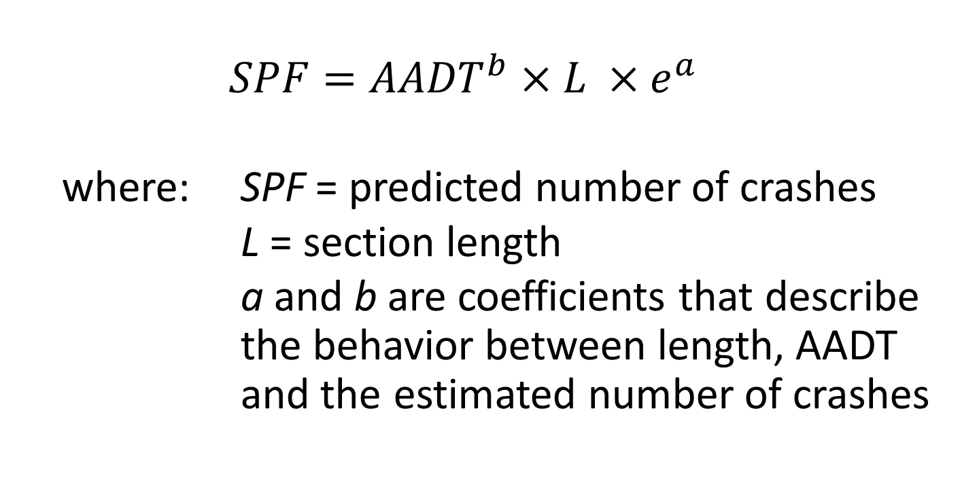
Regression Model – Safety Performance Function
  $$SPF={AADT}^{b}×L ×e^{a}$$
  where: SPF = predicted number of crashes
  L = section length
  a and b are coefficients that describe the behavior between length, AADT and the estimated number of crashes

Slide 19
Notes:
Kentucky

Slide 20
Empirical Bayes Estimate
Crashes (corrected for regression to the mean)
EB = (Weight)×SPF+(1-Weight)×Observed Crashes
Notes:
Avoid RTM

Slide 21
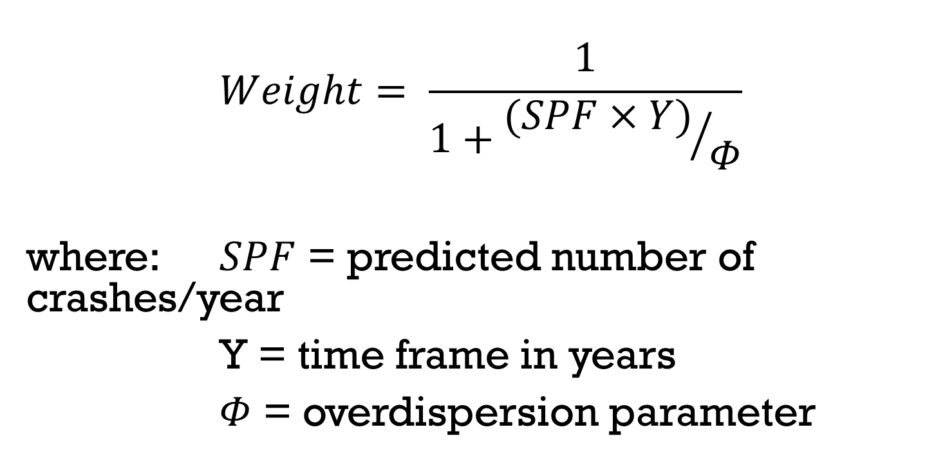
Empirical Bayes Weight
$$Weight= \frac{1}{1+{(SPF×Y)}/Φ}$$
where: $SPF$ = predicted number of crashes/year
Y = time frame in years
$Φ$ = overdispersion parameter

Slide 22
Overdispersion
High phi → SPF good representation on data
Low phi → greater reliance on crash data
Observed
Crashes
SPF
Observed
Crashes
SPF
Notes:
Low overdispersion is similar to a lower R² outliers are not removed: http://www.ncbi.nlm.nih.gov/pubmed/20441841. Phi is proportional to W. If crash data is spread out (like a low R2) then we don’t give as much weight to the model and rely more on site crash data .

Slide 25
Potential for Crash Reduction
Crashes per year
Observed Crashes
EB Crashes (Corrected)
PCR
Predicted Crashes from SPF
AADT
Notes:
Note that all of for specific site

Slide 26
7 of top 25 PCR are top 25 CRF list
20 of top 25 PCR are in top 100 CRF
SiteID | AADT | Observed | Length | PCR | Crash Rate | CRF
671 | 38672 | 252 | 0.957 | 156.2 | 373.1 | 2.83
512 | 14243 | 178 | 0.513 | 150.8 | 1334.9 | 10.13
29 | 3316 | 90 | 0.389 | 79.1 | 3823.1 | 29.03
472 | 13324 | 105 | 0.643 | 74.6 | 671.6 | 5.10
340 | 10037 | 74 | 0.249 | 63.3 | 1622.4 | 12.32
536 | 15052 | 120 | 1.423 | 49.2 | 307.0 | 2.33
611 | 18691 | 85 | 0.634 | 47.7 | 393.0 | 2.98
253 | 8451 | 50 | 0.125 | 44.7 | 2593.5 | 19.69
375 | 10894 | 61 | 0.533 | 39.4 | 575.6 | 4.37
347 | 10204 | 50 | 0.342 | 36.5 | 785.1 | 5.96
559 | 15742 | 63 | 0.537 | 35.1 | 408.4 | 3.10
652 | 22426 | 40 | 0.088 | 33.7 | 1110.6 | 8.43
631 | 20309 | 135 | 1.674 | 31.9 | 217.6 | 1.65
555 | 15526 | 55 | 0.477 | 30.5 | 406.9 | 3.09
473 | 13518 | 70 | 0.94 | 26.8 | 301.9 | 2.29
669 | 38407 | 68 | 0.427 | 25.9 | 227.2 | 1.72
522 | 14516 | 31 | 0.1 | 25.7 | 1170.2 | 8.88
662 | 25551 | 31 | 0.073 | 25.4 | 910.7 | 6.91
308 | 9364 | 27 | 0.03 | 25.3 | 5266.5 | 39.98
533 | 14833 | 38 | 0.255 | 25.1 | 550.5 | 4.18
647 | 22206 | 82 | 0.869 | 24.8 | 232.8 | 1.77
537 | 15052 | 27 | 0.075 | 22.9 | 1310.5 | 9.95
535 | 14935 | 36 | 0.265 | 22.6 | 498.4 | 3.78
273 | 8887 | 37 | 0.414 | 22.6 | 551.0 | 4.18
SiteID | AADT | Observed | Length | PCR | Crash Rate | CRF
6 | 2605 | 20 | 0.035 | 18.3 | 12019.6 | 91.25
308 | 9364 | 27 | 0.03 | 25.3 | 5266.5 | 39.98
137 | 6268 | 3 | 0.005 | 2.8 | 5245.2 | 39.82
25 | 3234 | 17 | 0.064 | 15.1 | 4500.6 | 34.17
29 | 3316 | 90 | 0.389 | 79.1 | 3823.1 | 29.03
633 | 20581 | 8 | 0.006 | 7.5 | 3549.8 | 26.95
120 | 6088 | 9 | 0.023 | 8.1 | 3521.9 | 26.74
7 | 2605 | 7 | 0.049 | 5.9 | 3004.9 | 22.81
253 | 8451 | 50 | 0.125 | 44.7 | 2593.5 | 19.69
23 | 3183 | 1 | 0.008 | 0.8 | 2151.8 | 16.34
663 | 25551 | 17 | 0.019 | 15.4 | 1918.8 | 14.57
31 | 3492 | 9 | 0.074 | 7.4 | 1908.4 | 14.49
160 | 6814 | 9 | 0.043 | 7.6 | 1683.1 | 12.78
340 | 10037 | 74 | 0.249 | 63.3 | 1622.4 | 12.32
594 | 17790 | 14 | 0.027 | 12.3 | 1597.1 | 12.13
65 | 4608 | 9 | 0.073 | 7.2 | 1466.0 | 11.13
306 | 9299 | 10 | 0.044 | 8.3 | 1339.2 | 10.17
512 | 14243 | 178 | 0.513 | 150.8 | 1334.9 | 10.13
560 | 15742 | 25 | 0.066 | 21.3 | 1318.5 | 10.01
537 | 15052 | 27 | 0.075 | 22.9 | 1310.5 | 9.95
117 | 5920 | 19 | 0.137 | 15.1 | 1283.7 | 9.75
525 | 14602 | 18 | 0.057 | 15.0 | 1185.0 | 9.00
553 | 15456 | 5 | 0.015 | 4.2 | 1181.7 | 8.97
522 | 14516 | 31 | 0.1 | 25.7 | 1170.2 | 8.88
Spearman’s Rho of 0.72
Notes:
Rural 4-lane divided SPF Kentucky. Look at site #23: a low AADT and only one crash, yet a CRF of 16. Sites that are not highlighted represent site corrected for RTM or sites where the SPF’s non-linear models better represents the crash data
This shows that they are not drastically different. Different enough to affect the priority of top projects.
Notice the extremely high CRF – site #6. This is likely an intersection. It is a very small section with low AADT and high crashes.

Slide 27
Comparison of PCRs
PCRs should be compared across similar highway types or functional class
PCRs already account for AADT but much higher PCRs are observed for higher class roadways
This causes higher AADT facilities to rise to the top
Benefit-cost analysis is needed to factor in the cost of an improvement
This becomes unusable for system wide ratings
Notes:
You can use different crash types if the countermeasures are different

Slide 28
Casino Revisited
AADT = 15,000
Crashes (5 years) = 50
Crash Rate = 179
Length = 1.0 mile
AADT = 30,000
Crashes (5 years) = 85
Crash Rate = 155
Length = 1.0 mile
Notes:
Based on an actual example in Colorado

Slide 29
y=x^(0.73827)*e^(-3.20716)
phi=0.9345
Notes:
SPF scaled for 5 years in unit length (mile).

Slide 30
Casino Revisited
Before
After
AADT = 15,000
Crashes (5 years) = 50
Length = 1.0 mile
SPF = 49.0
W = 0.019*
Corrected = 50.0
PCR = 1.0
AADT = 30,000
Crashes (5 years) = 85
Length = 1.0 mile
SPF = 81.7
W = 0.011*
Corrected = 85.0
PCR = 3.2
*low model weight
Notes:
Idea based on an actual example in Colorado. Note low model weight could be improved with baseline SPF. Not a regression to the mean example but rather CRF assumes crashes are linear compared to AADT

Slide 31
Before and After
 | AADT | SPF | Observed | Crash Rate | Weight | Corrected | CRF | PCR
Before Casino | 15000 | 49.0 | 50 | 182.6 | 0.019 | 50.0 | 1.077 | 1.0
After Casino | 30000 | 81.7 | 85 | 155.3 | 0.011 | 85.0 | 0.998 | 3.2

Slide 32
Summary
Casinos aren’t necessarily good for highway safety
Traditional methods have known limitations
  Crashes and AADT aren’t necessarily linearly related
  CRF doesn’t address RTM bias
There are better, more science-based approaches to safety
  The HSM!

Slide 33
Questions?
Eric Green, PhD, PE, GISP
Kentucky Transportation Center
Research Engineer
eric.green@uky.edu
http://www.ktc.uky.edu
Phone: (859) 257-2680

